Slide 1
Building Android apps – Week 13a
2843-201710_MCS4993_M:Topics in MA/CS
2843-201710_MCS5993_M:Topics in Computer Science

Slide 2
Agenda
Chap1: Espresso
Chap3: Tools of the trade

Slide 3
Espresso
ViewMatchers
Used to find a view
ViewActions
Act on a view
ViewAssertions
Similar to unit test assertions
Notes:
GUI tests are tests on Activities and unit tests are tests on individual methods in your code. We won’t need as many GUI tests as unit tests, but we’re still going to have to test every activity for happy paths as well as not so happy paths.

Slide 4
Espresso
Prerequisites
Install the Android Support Repository
Put the test classes in the src/androidTest/java folders
Add Espresso dependency in build.gradle (app) file

Slide 5
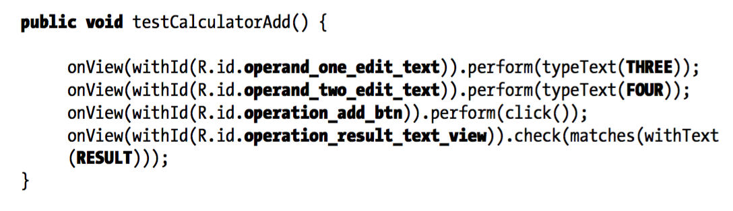
Espresso
Notes:
GUI tests are tests on Activities and unit tests are tests on individual methods in your code. We won’t need as many GUI tests as unit tests, but we’re still going to have to test every activity for happy paths as well as not so happy paths.

Slide 6
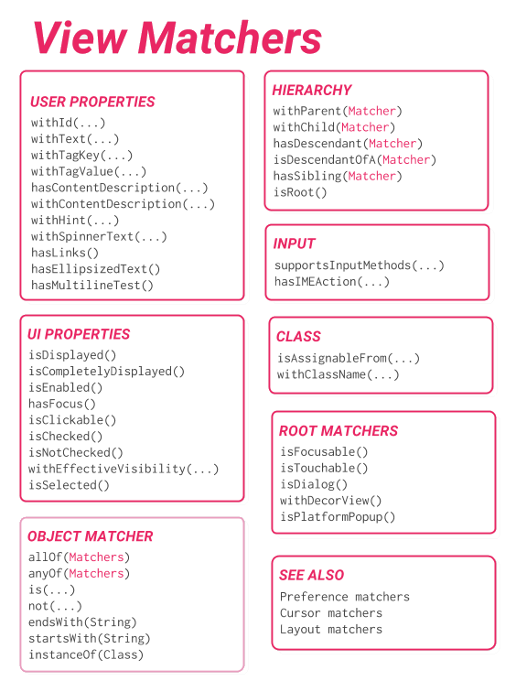

Slide 7
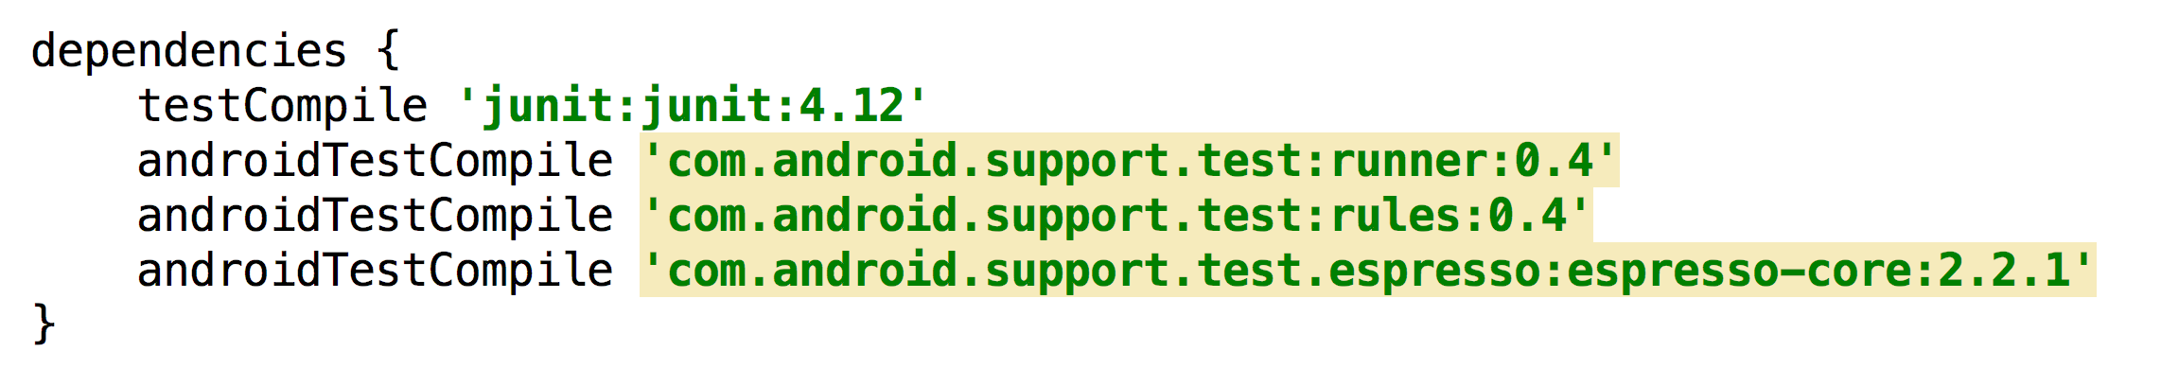
build.gradle

Slide 8
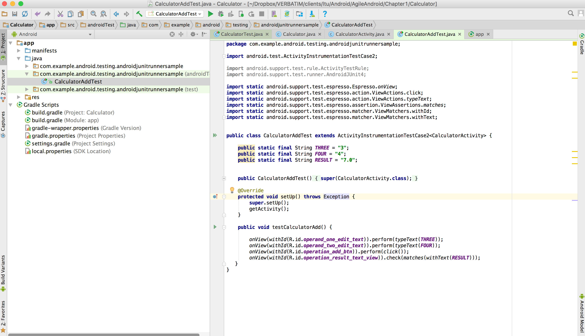
Notes:
DEMO

Slide 9
Github
http://github.com/godfreynolan/AgileAndroid

Slide 10
Third Party Tools
Hamcrest for better assertions
Mockito to keep unit tests small
Robolectric to test Activities
Jenkins to automate testing

Slide 11
Hamcrest
More assertions
Custom assertions
Notes:
Anything more than a simple Hello, World-type application is probably going to need better assertions than those that come with JUnit 4.x.
Hamcrest is one option that offers a lot more matchers. There are lots of other assertions libraries

Slide 12
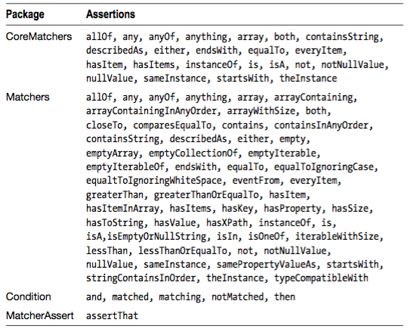
Notes:
Anything more than a simple Hello, World-type application is probably going to need better assertions than those that come with JUnit 4.x. Hamcrest is one option that offers a lot more matchers.

Slide 13
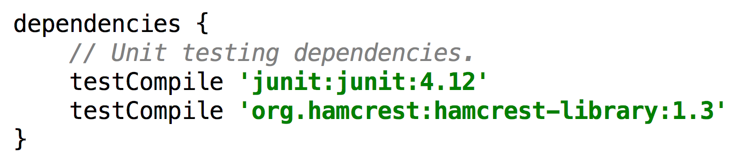
Hamcrest build.gradle

Slide 14
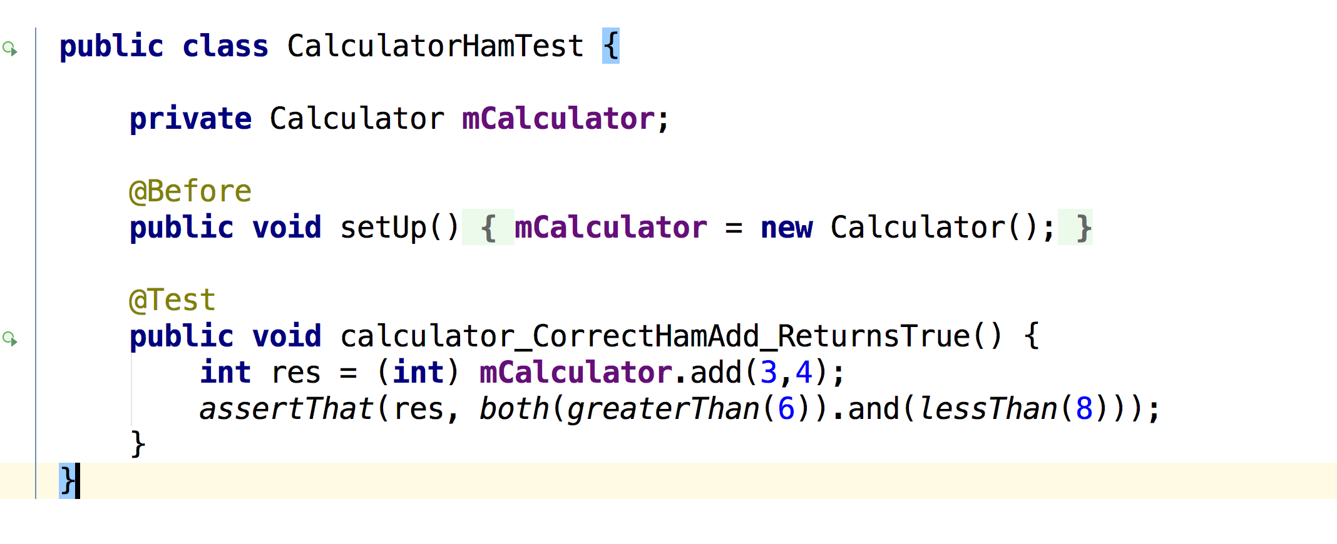
Hamcrest Test class

Slide 15
Notes:
DEMO

Slide 16
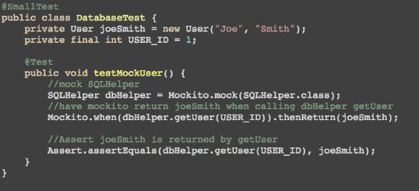
Mockito
when(methodIsCalled).thenReturn(aValue);
Notes:
in the section “Grouping Tests,” we talked about small, medium, and large tests. In reality, unit tests should always be small tests. But if we’re making network connections or reading from the file system or database, then by definition we’re not performing small unit tests. We use mocking frameworks to mock out any code that talks to external resources and get all of our unit tests back to the smaller group. Mockito works very well with Android Studio, so we’re going to use that tool in this and subsequent chapters.

Slide 17
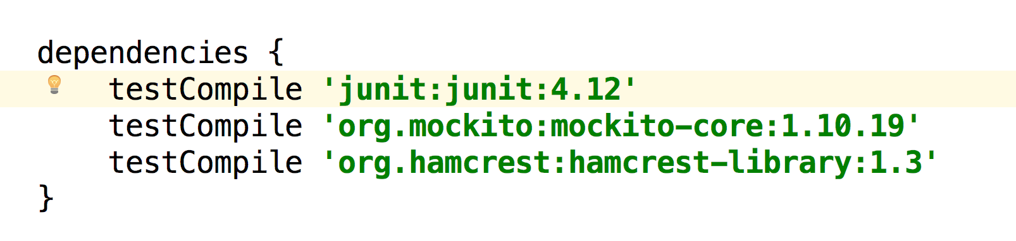
Mockito build.gradle
Notes:
Added the mockito library

Slide 18
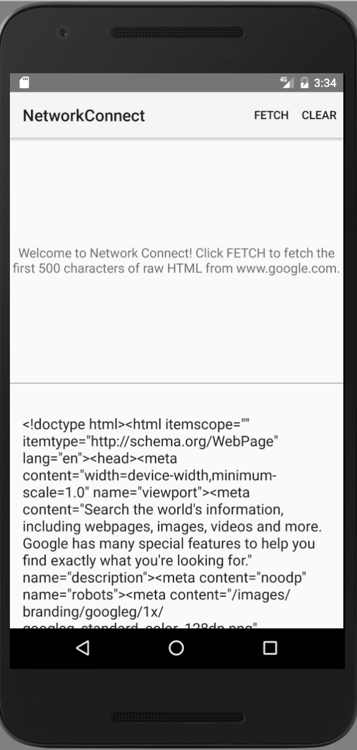

Slide 19
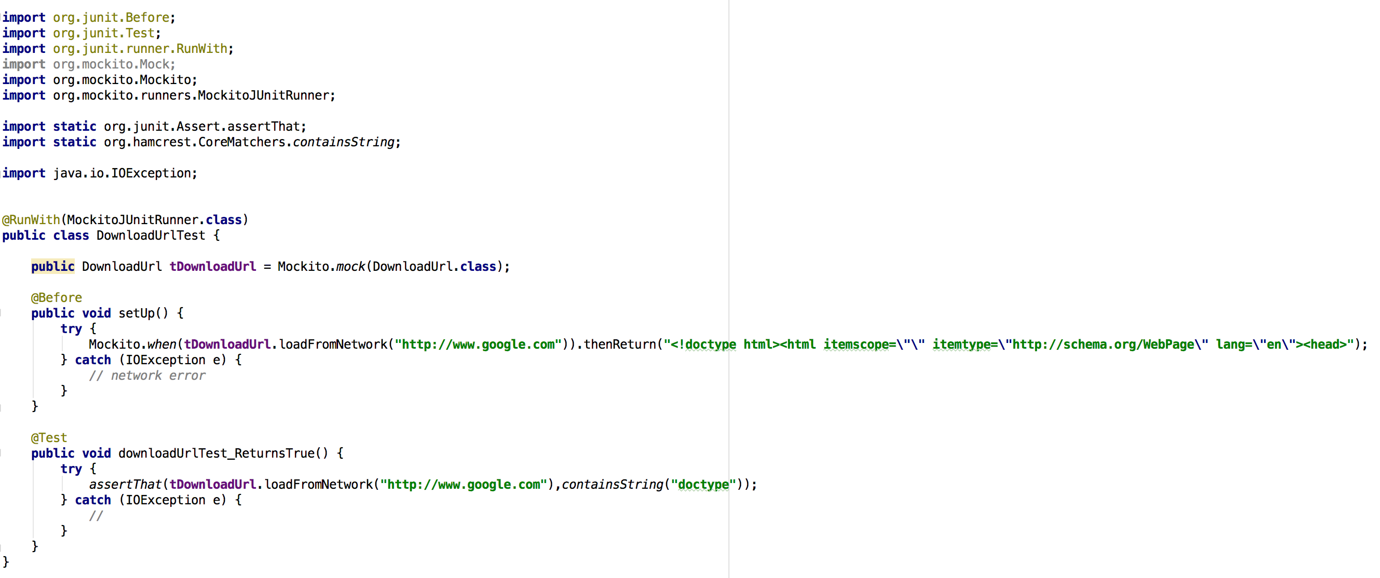
Mockito Test class
Notes:
Because we’re making a network call, we should mock out the network access using Mockito Mockito test class everytime we want to connect to the backend then we’ll have a hard coded HTML string

Slide 20
Notes:
DEMO

Slide 21
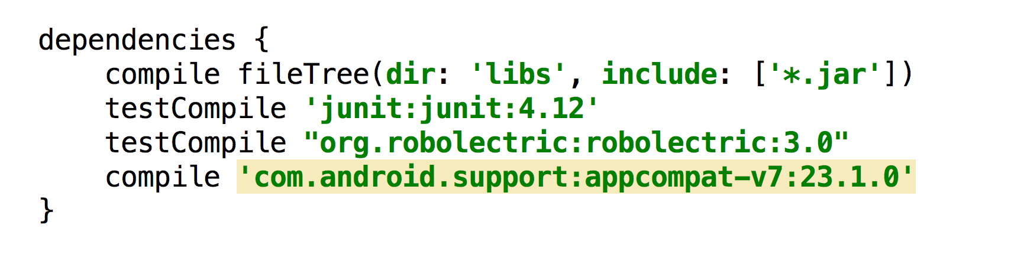
Robolectric
Notes:
You can’t test Android apps unless you test Android activities. You can test around it using tools like Mockito and JUnit but you’re missing a key element of your app if you’re not testing its activities.

Slide 22
Robolectric config

Slide 23
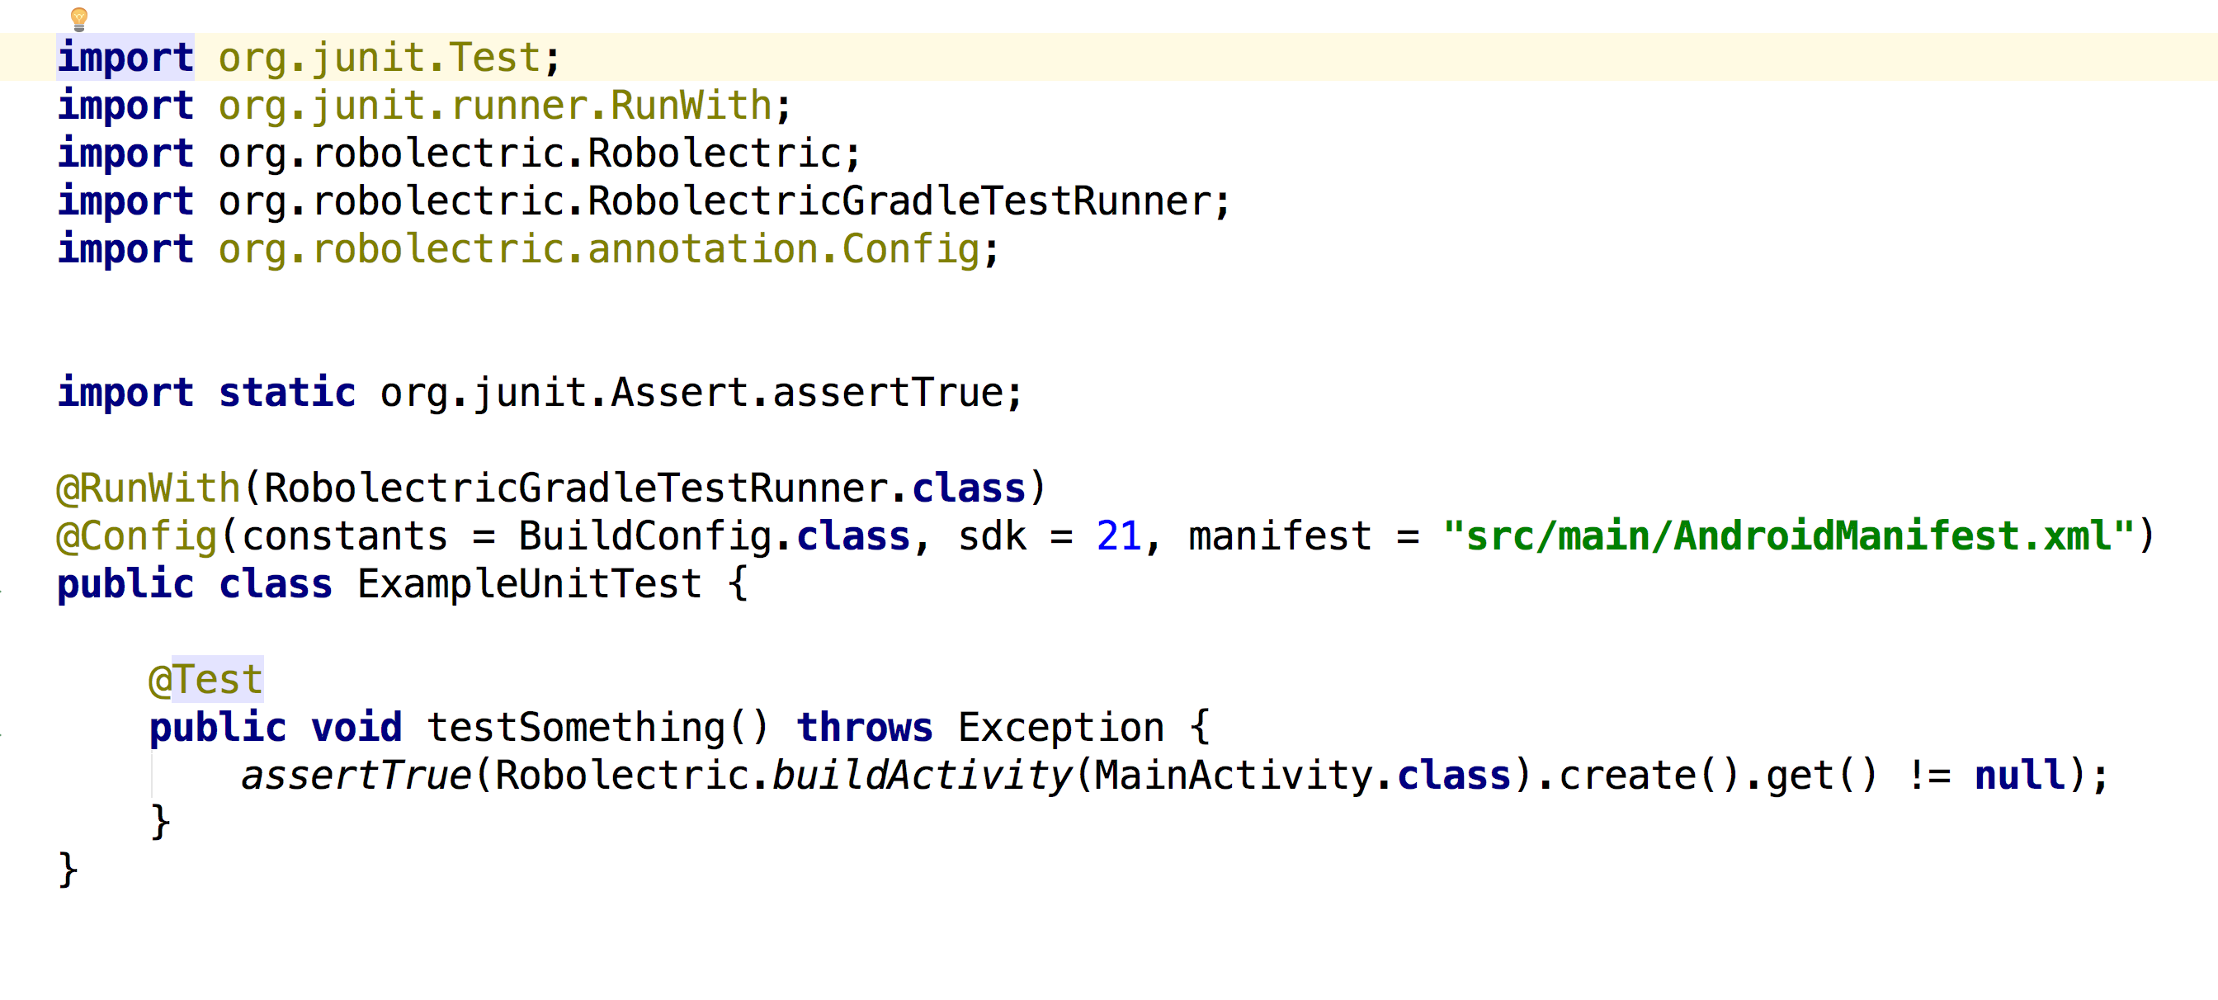
Robolectric Test class
Notes:
Note the configuration information which sets the target SDK to API 21 and tells Robolectric where to find the AndroidManifest.xml file.
Run the test in the same way you would run unit tests by right clicking on the test class name and choosing ’Run RobolectricTest’. The test passes without the need for an emulator. Relatively speaking Robolectric tests take longer than JUnit4 tests but they are still considerably faster than emulator tests.

Slide 24
Notes:
DEMO

Slide 25
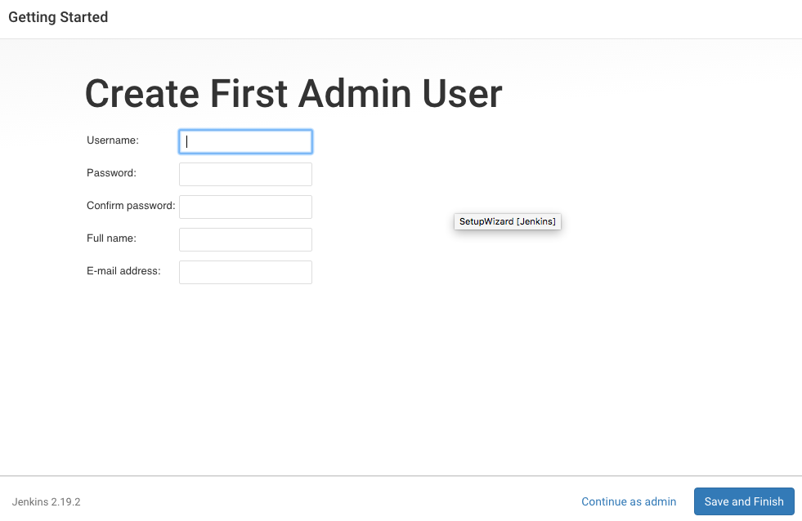
Jenkins

Slide 26
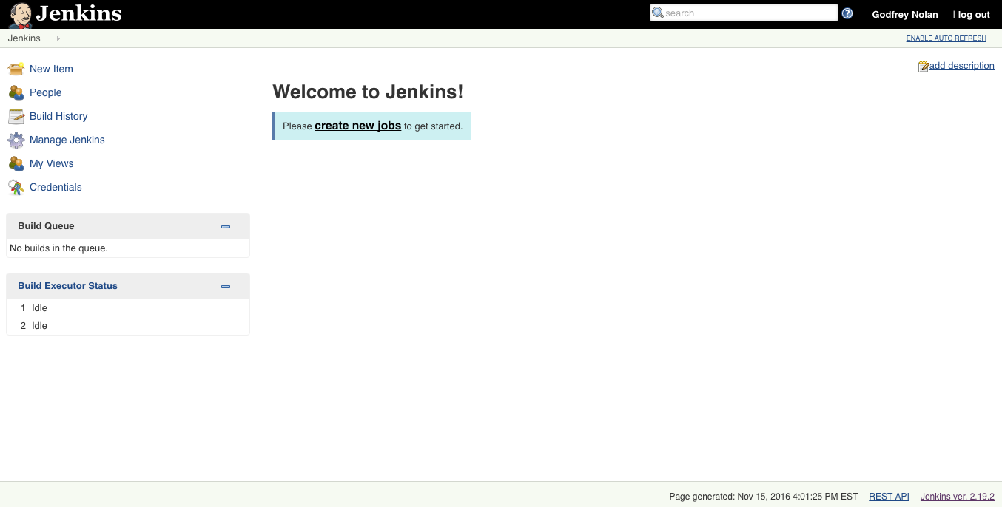
Jenkins

Slide 27
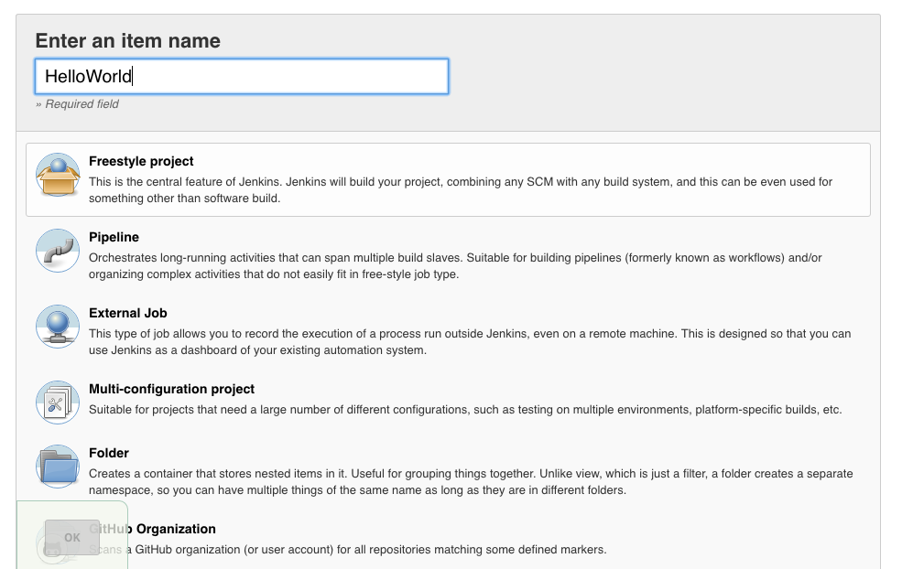
Jenkins

Slide 28
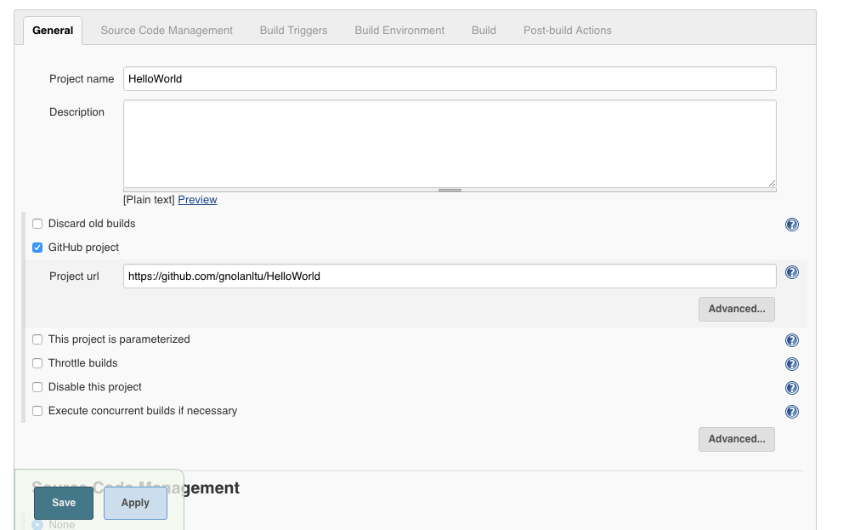
Jenkins

Slide 29
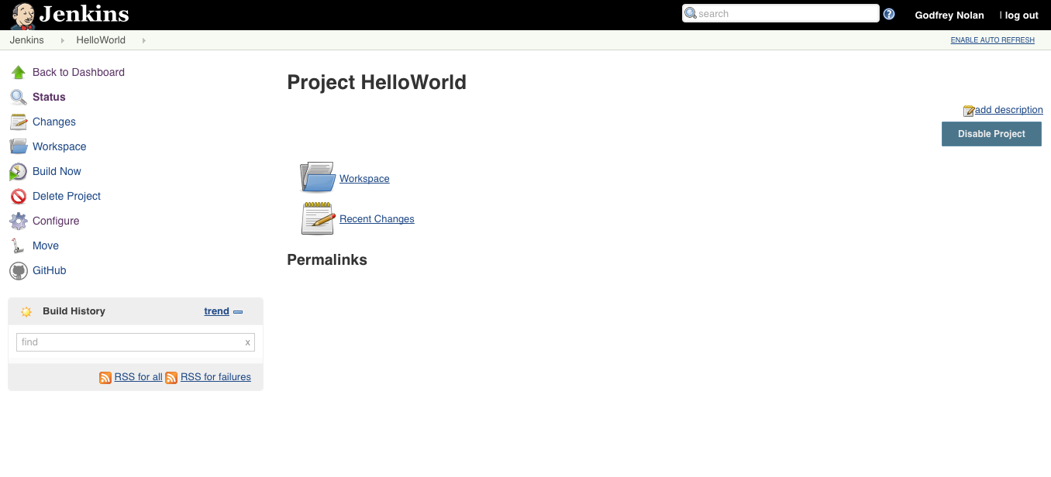
Jenkins

Slide 30
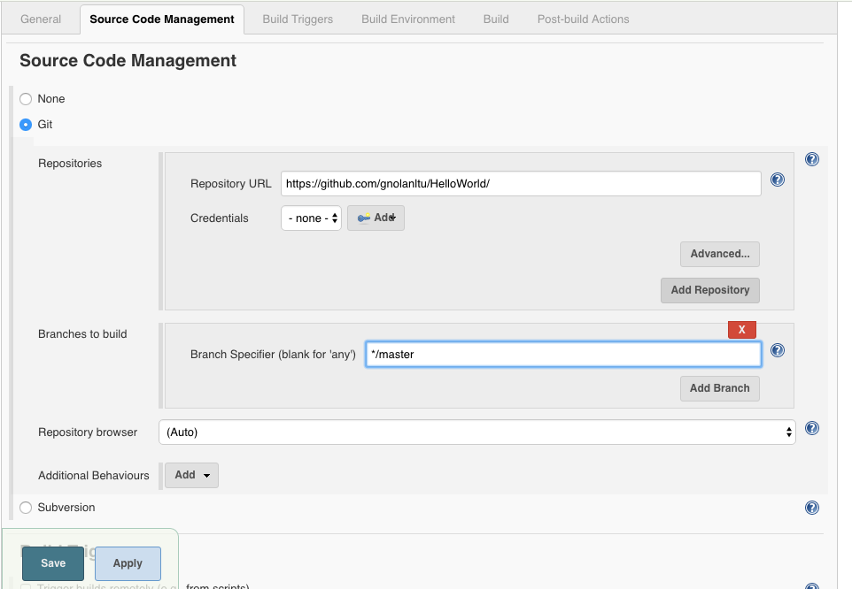
Jenkins
Notes:
Create a file in the root directory of your project called "local.properties"
Put only the following in the file: sdk.dir=/home/patience/android-studio/sdk

Slide 31
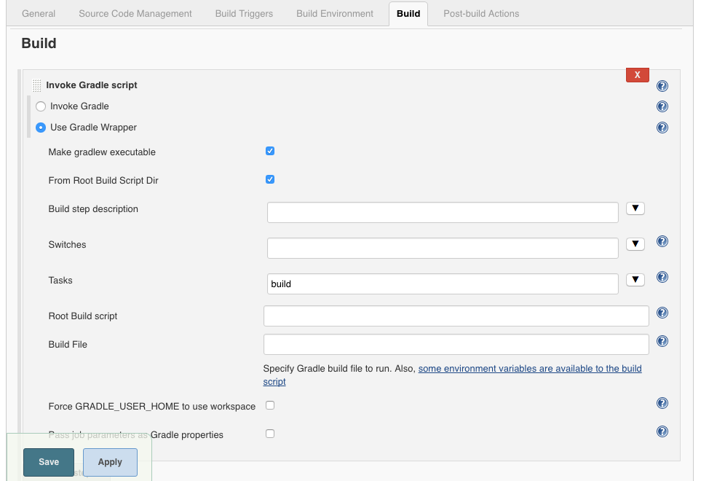
Jenkins
Notes:
Get it to run from your command line first

Slide 32
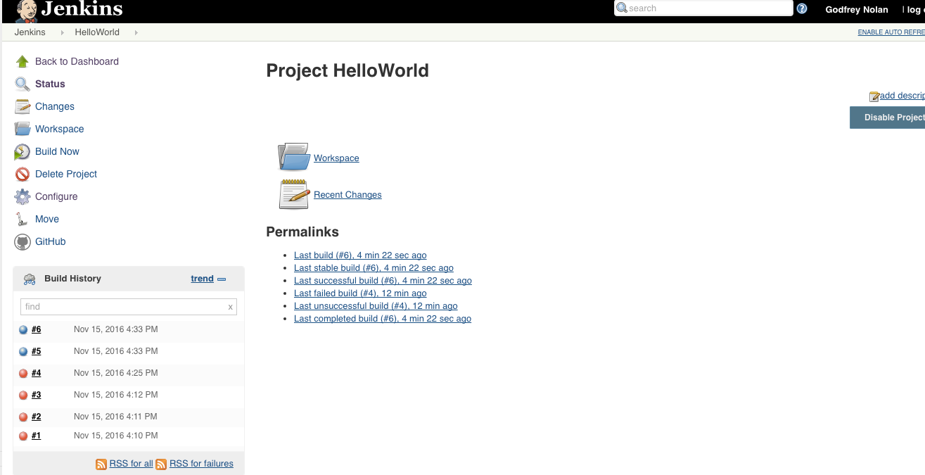
Jenkins

Slide 33
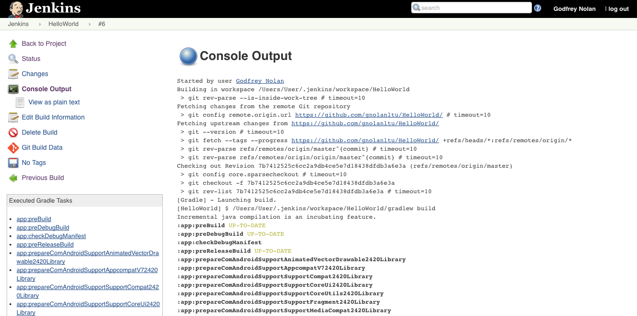
Jenkins

Slide 34
Thursday
User Interface Testing
Assignment – To do list using sqlite (over thanksgiving)

